Slide 1

CS 484 Intro to Machine Learning
Week 6
September 30, 2020

Slide 2
Week 6: Learner Evaluation and Comparison
Motivation
Metrics
Methods
Chapter 7 and Chapter 8 of the Machine Learning book

Slide 3
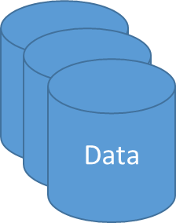
Machine Learning Life Cycle
Ask the Question
Specify What to Learn
Retrieve Data
Train Algorithms
Deploy Algorithm
Collect Feedback
Use Feedback
Important Question
How can I be sure that a machine learning algorithm will work in deployment?
Define “Sure”
Define “Work”
Define “Deployment”

Slide 4
Surety in Deployment
Deployment = Apply the results of the machine learning algorithm (a.k.a. the model)
on a different data
in a different environment
at a future time
by someone else
that make real impact
There are many things, foreseeable or not, that may be out of my control in deployment
We may need to simulate or practice a deployment while things are still under my control.
The two R concepts: Reproducibility and Replicability.

Slide 5

Reproducibility
ME
1. Start from the original data
4. On same or compatible machine
5. Reproduce the same results and conclusions
2. Use the same algorithms
3. Execute the same tasks

Slide 6
Reproducibility
If the expected results cannot be reproduced, this indicates there are some unexplained (intentional or random) interactions among the data, the algorithm, and the machine.
Common causes are:
Uninitialized variables in the codes
Inaccurate documentation of the activity (e.g., random cluster centroids are generated without offering to set the random seed)

Slide 7
Replicability
S/HE
1. Use a different data in same business context
4. On compatible machine
5. Lead to the similar conclusions
2. Use the same algorithms
3. Execute the same tasks

Slide 8
Replicability
If the expected conclusions cannot be replicated, this indicates there are some design flaws in the tasks.
Common causes are:
Some correlations among the features are not accounted for
Degenerated data are not properly handled
The algorithm will only work for specialized data scenarios (e.g., no missing values).
Incomplete documentation (e.g., need a particular hotfix)

Slide 9
Surety in Deployment
Confidence
Someone else can replicate our results or conclusions by applying the algorithm on different data
Objective
in Deployment
We ensure the models are not too tailor-made for the modeler
Anticipate
for the Unexpected in Deployment
A sportscar that runs smoothly inside a wind tunnel may not have the same performance while being driven through the winter Chicago traffic (with potholes)!
in machine learning algorithm
We build the models in a lab but someone else uses the models for running their business
The Olympic 100-meters dash athletes do not record their own times
We can reproduce our own results again and again

Slide 10



A Common Practice
A common practice is to separate the original observations into two, or occasionally three, partitions.
Training
Testing
Hold-Out

Slide 11
Data Partitions
Training
For training (i.e., building) the model
Determine model structure
Testing
For assessing the performance of the model
Compare performance among models
Hold-Out
Calculate model parameters
Play the role of a “future data”
Often used in data challenge
Obtain an objective estimate of the error size
Play the role of a “third party” data

Slide 12
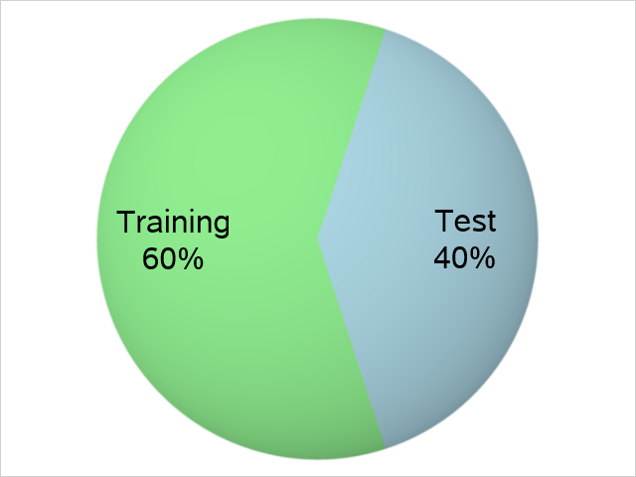
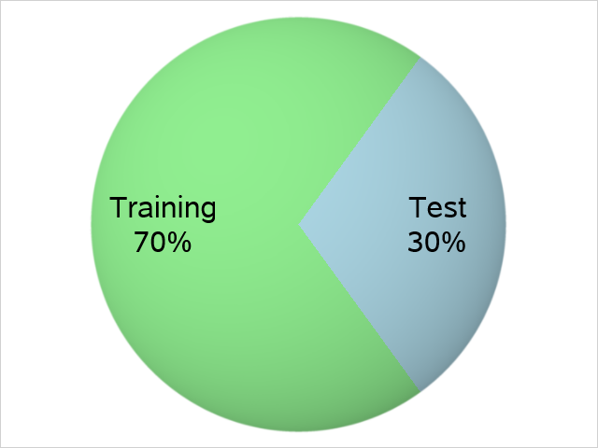
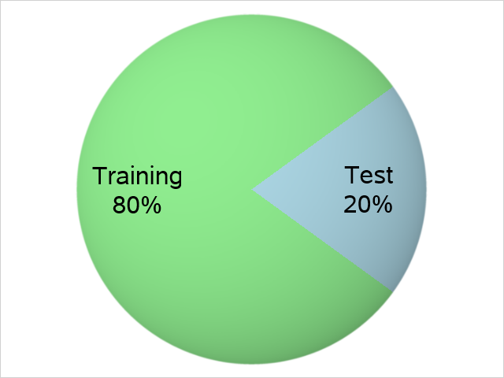
When Hold-Out Partition Not Needed
Unless we have to report model performance on a third-party benchmark dataset, we typically do not need the Hold-Out partition
Large or Good Data
Typical Allocation
Small or Noisy Data

Slide 13
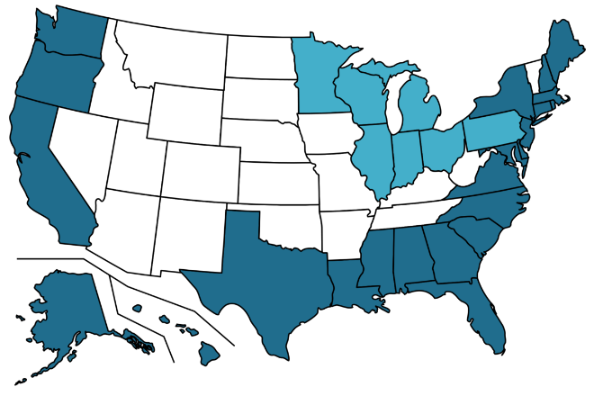
Partition Data by a Pre-Defined Group
By Chronological Variables
Build the customer sentiment models built on historical data from 2015 to 2017
Then compare models based on “future” data from 2018
By Geographical Variables
Build the marketing campaign models based on the US coastal states
Then compare models based on the US inland states
2015
2016
2018
2017

Slide 14
Partition Data by Statistical Sampling
Simple Random Sampling (SRS)
Categorical or Continuous target variable
Sampling without replacement
Stratified Simple Random Sampling
Categorical target variable
Sample size in each stratum is proportional to the size of the stratum

Slide 15
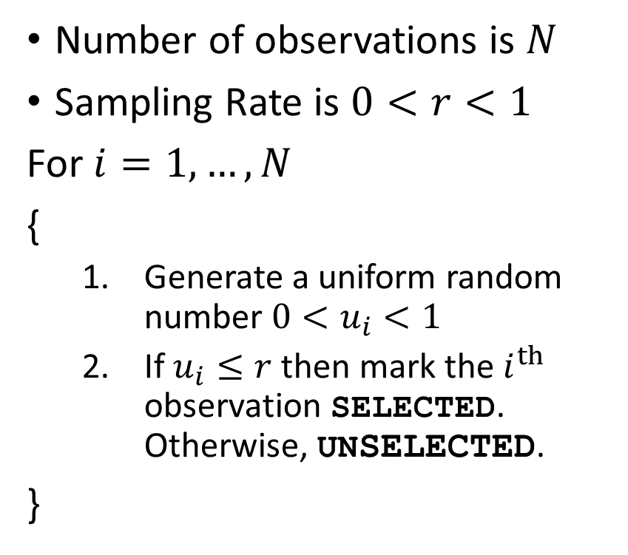
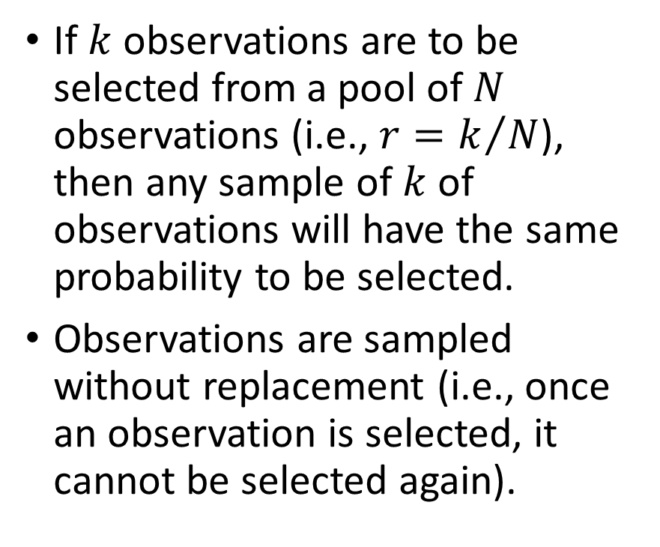
Simple Random Sampling (SRS)
Number of observations is $N$
Sampling Rate is $0<r<1$
For $i=1,…,N$
{
Generate a uniform random number $0<u_{i}<1$
If $u_{i}≤r$ then mark the $i^{th}$ observation SELECTED. Otherwise, UNSELECTED.
}
If $k$ observations are to be selected from a pool of $N$ observations (i.e., $r=k/N$), then any sample of $k$ of observations will have the same probability to be selected.
Observations are sampled without replacement (i.e., once an observation is selected, it cannot be selected again).

Slide 16
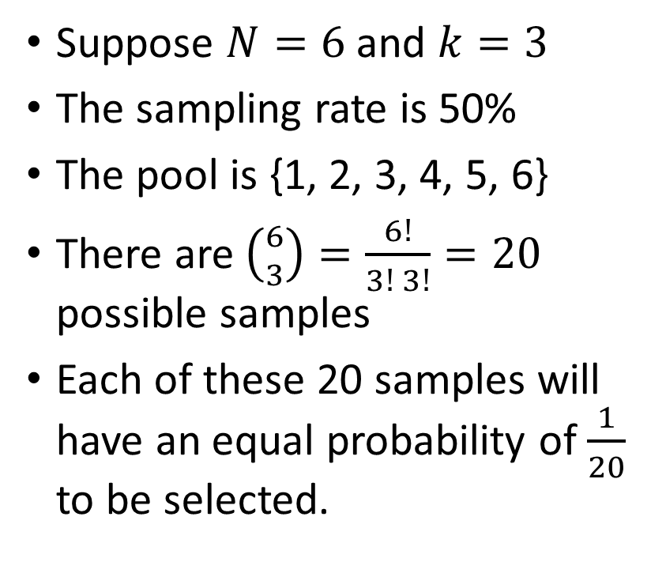
Simple Random Sampling (SRS)
Suppose $N=6$ and $k=3$
The sampling rate is 50%
The pool is {1, 2, 3, 4, 5, 6}
There are $\left({6 \atop 3}\right)=\frac{6!}{3! 3!}=20$ possible samples
Each of these 20 samples will have an equal probability of $\frac{1}{20}$ to be selected.
The 20 possible samples are: {1,2,3}, {1,2,4}, {1,2,5}, {1,2,6}, {1,3,4}, {1,3,5}, {1,3,6}, {1,4,5}, {1,4,6}, {1,5,6}, {2,3,4}, {2,3,5}, {2,3,6}, {2,4,5}, {2,4,6}, {2,5,6}, {3,4,5}, {3,4,6}, {3,5,6}, {4,5,6}.

Slide 17
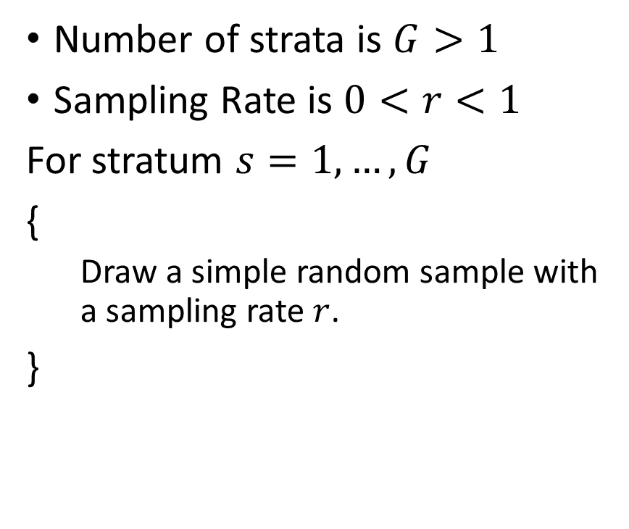
Stratified Simple Random Sampling
Number of strata is $G>1$
Sampling Rate is $0<r<1$
For stratum $s=1,…,G$
{
Draw a simple random sample with a sampling rate $r$.
}
The strata must be disjoint groups.
The sample size in each stratum is proportional to the size of the stratum.
Observations are sampled without replacement (i.e., once an observation is selected, it cannot be selected again).

Slide 18
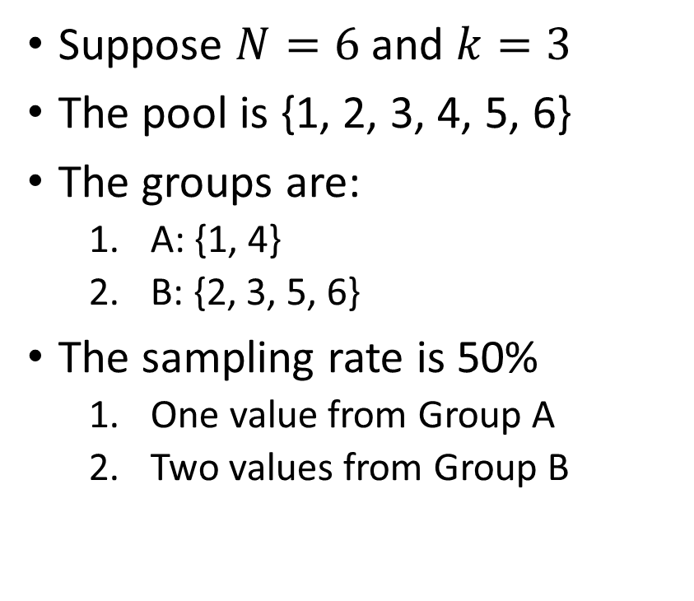
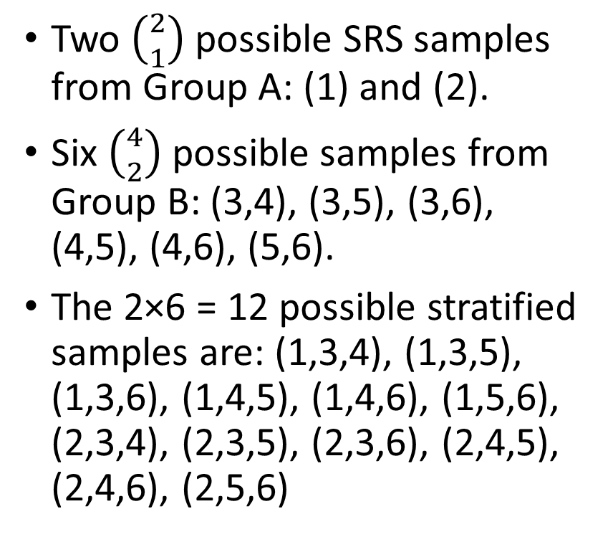
Stratified Simple Random Sampling
Suppose $N=6$ and $k=3$
The pool is {1, 2, 3, 4, 5, 6}
The groups are:
A: {1, 4}
B: {2, 3, 5, 6}
The sampling rate is 50%
One value from Group A
Two values from Group B
Two $\left({2 \atop 1}\right)$ possible SRS samples from Group A: (1) and (2).
Six $\left({4 \atop 2}\right)$possible samples from Group B: (3,4), (3,5), (3,6), (4,5), (4,6), (5,6).
The 2×6 = 12 possible stratified samples are: (1,3,4), (1,3,5), (1,3,6), (1,4,5), (1,4,6), (1,5,6), (2,3,4), (2,3,5), (2,3,6), (2,4,5), (2,4,6), (2,5,6)

Slide 19
Python Function for Partitioning Data
Function:
sklearn.model_selection.train_test_split (*arrays, **options)
Description:
Split arrays or matrices into the random train and test subsets
Reference:
http://scikit-learn.org/stable/modules/generated/sklearn.model_selection.train_test_split.html#sklearn.model_selection.train_test_split

Slide 20
Simple Random Sampling
import pandas
from sklearn.model_selection import train_test_split
hmeq = pandas.read_csv('C:\\Users\\minlam\\Documents\\IIT\\Machine Learning\\Data\\hmeq.csv’, delimiter=',’)
print('Number of Missing Values:')
hmeq.isna().sum()
hmeq_train, hmeq_test = train_test_split(hmeq, test_size = 0.3, random_state = 60616)
Week 6 Partition Data.py

Slide 21
Simple Random Sampling
test_size = 0.3
Assign 30% of observations to the Testing partition
Assign 70% observations to the Training partition
random_state = 60616
The random seed is 60616
Original number of observations in hmeq.csv is 5,960
The Training partition has 5,960 × 70% = 4,172 observations
The Test partition has 5,960 × 30% = 1,788 observations

Slide 22
Simple Random Sampling
Look at the distribution of the target variable BAD in the training and the testing partitions.
hmeq_train.groupby('BAD').size() / hmeq_train.shape[0]
BAD
0 0.795542
1 0.204458
hmeq_test.groupby('BAD').size() / hmeq_test.shape[0]
BAD
0 0.812081
1 0.187919

Slide 23
Simple Random Sampling
The probability that an observation will go to either partition is
Prob(Training) = 0.7
Prob(Testing) = 0.3
Given an observation in the Training partition
Prob(BAD=0 | Training) = 0.795542
Given an observation in the Testing partition
Prob(BAD=0 | Testing) = 0.812081
Prob(BAD=1 | Training) = 0.204458
Prob(BAD=1 | Testing) = 0.187919

Slide 24
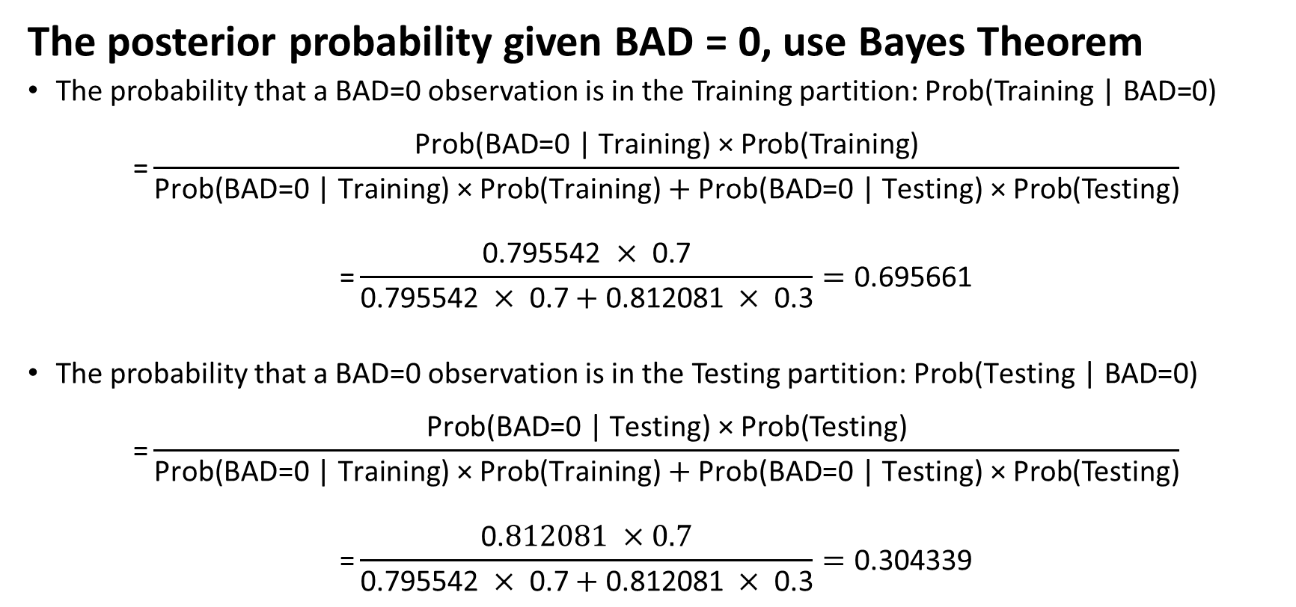
Simple Random Sampling
The posterior probability given BAD = 0, use Bayes Theorem
The probability that a BAD=0 observation is in the Training partition: $\text{Prob}\text{(}\text{Training}\text{ | }\text{BAD}\text{=0)}$
$$\text{=}\frac{\text{Prob}\text{(}\text{BAD}\text{=0 | }\text{Training}\text{) × }\text{Prob}\text{(}\text{Training}\text{)}}{\text{Prob}\text{(}\text{BAD}\text{=0 | }\text{Training}\text{) × }\text{Prob}\text{(}\text{Training}\text{)}+\text{Prob}\text{(}\text{BAD}\text{=0 | }\text{Testing}\text{) × }\text{Prob}\text{(}\text{Testing}\text{)}}$$
$$\text{=}\frac{\text{0.795542 }×\text{ 0.7}}{\text{0.795542 }×\text{ 0.7}+\text{0.812081 }×\text{ 0.3}}=\text{0.695661}$$
The probability that a BAD=0 observation is in the Testing partition: $\text{Prob}\text{(}\text{Testing}\text{ | }\text{BAD}\text{=0)}$
$$\text{=}\frac{\text{Prob}\text{(}\text{BAD}\text{=0 | }\text{Testing}\text{) × }\text{Prob}\text{(}\text{Testing}\text{)}}{\text{Prob}\text{(}\text{BAD}\text{=0 | }\text{Training}\text{) × }\text{Prob}\text{(}\text{Training}\text{)}+\text{Prob}\text{(}\text{BAD}\text{=0 | }\text{Testing}\text{) × }\text{Prob}\text{(}\text{Testing}\text{)}}$$
$$\text{=}\frac{\text{0.}812081 ×0.7}{\text{0.795542 }×\text{ 0.7}+\text{0.812081 }×\text{ 0.3}}=\text{0.304339}$$

Slide 25
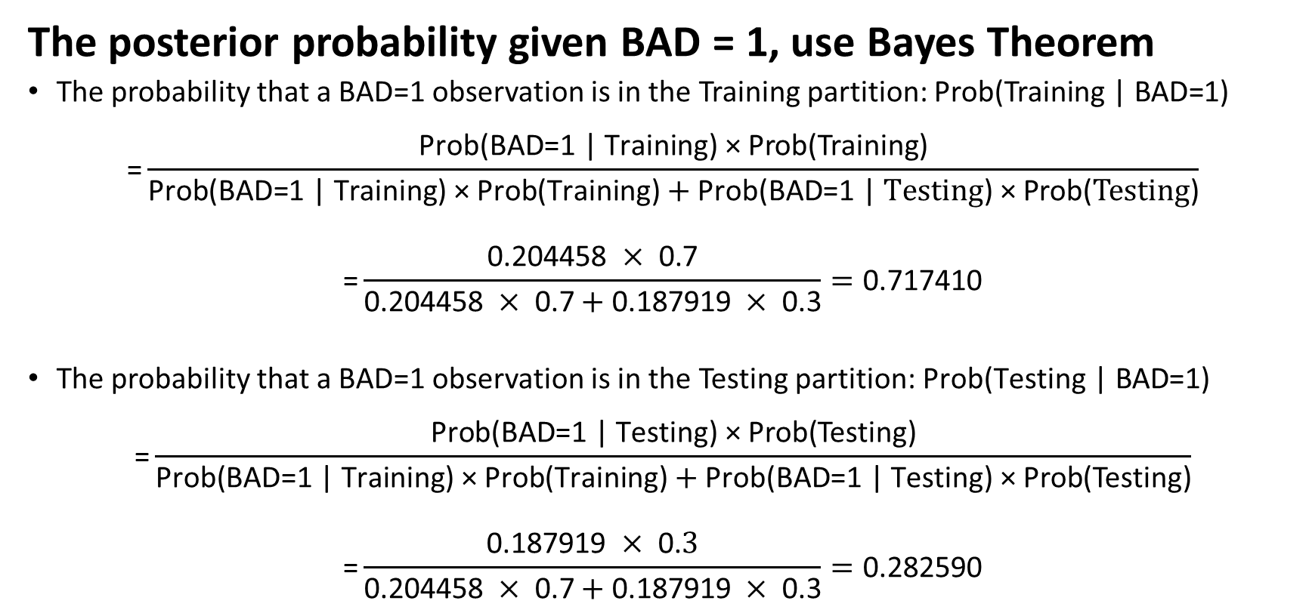
Simple Random Sampling
The posterior probability given BAD = 1, use Bayes Theorem
The probability that a BAD=1 observation is in the Training partition: $\text{Prob}\text{(}\text{Training}\text{ | }\text{BAD}\text{=1)}$
$$\text{=}\frac{\text{Prob}\text{(}\text{BAD}\text{=1 | }\text{Training}\text{) × }\text{Prob}\text{(}\text{Training}\text{)}}{\text{Prob}\text{(}\text{BAD}\text{=1 | }\text{Training}\text{) × }\text{Prob}\text{(}\text{Training}\text{)}+\text{Prob}\text{(}\text{BAD}\text{=1 | }Testing\text{) × }\text{Prob}\text{(}Testing\text{)}}$$
$$\text{=}\frac{\text{0.204458} ×\text{ 0.7}}{\text{0.}\text{204458} ×\text{ 0.7}+\text{0.}\text{187919} ×\text{ 0.3}}=\text{0.}\text{7}\text{1}\text{7410}$$
The probability that a BAD=1 observation is in the Testing partition: $\text{Prob}\text{(}\text{Testing}\text{ | }\text{BAD}\text{=1)}$
$$\text{=}\frac{\text{Prob}\text{(}\text{BAD}\text{=1 | }\text{Testing}\text{) × }\text{Prob}\text{(}\text{Testing}\text{)}}{\text{Prob}\text{(}\text{BAD}\text{=1 | }\text{Training}\text{) × }\text{Prob}\text{(}\text{Training}\text{)}+\text{Prob}\text{(}\text{BAD}\text{=1 | }\text{Testing}\text{) × }\text{Prob}\text{(}\text{Testing}\text{)}}$$
$$\text{=}\frac{\text{0.}\text{187919} ×\text{ 0.}3}{\text{0.204458 }×\text{ 0.7}+\text{0.187919 }×\text{ 0.3}}=\text{0.}\text{282590}$$

Slide 26
Simple Random Sampling
BAD = 1 observations have slightly higher chance to be assigned to the Training partition, but lower chance to the Testing partition
Posterior Probabilities
Prob(Training | BAD=0) = 0.695661
Prob(Training | BAD=1) = 0.717410
Prob(Testing | BAD=0) = 0.304339
Prob(Testing | BAD=1) = 0.282590
For a model that is accurately trained to predict BAD=1 observations in the training partition, it is slightly unfair to apply that model to the Testing partition.
For a model that is accurately trained to predict BAD=0 observations, the model already has the advantage when applied to the Testing partition.

Slide 27
Stratified Simple Random Sampling
print(hmeq.groupby('BAD').size() / hmeq.shape[0])
BAD
0 0.800503
1 0.199497
BAD = 0 in 80.0503% of the original observations
BAD = 1 in 19.9497% of the original observations
Stratified Sampling aims to maintain this distribution in both the Training and the Testing partitions.

Slide 28
Stratified SRS
hmeq_train, hmeq_test = train_test_split(hmeq, test_size = 0.3, random_state = 60616, stratify = hmeq['BAD'])
print('Number of Observations in Training = ', hmeq_train.shape[0])
print('Number of Observations in Testing = ', hmeq_test.shape[0])
Number of Observations in Training = 4172
Number of Observations in Testing = 1788
Stratified sampling still assigns 30% of 5,960 (which is 1,788) observations to the Testing partition.
The remaining 70% (i.e., 4,172) observations go to the Training partition.

Slide 29
Stratified SRS
print(hmeq_train.groupby('BAD').size() / hmeq_train.shape[0])
BAD
0 0.800575
1 0.199425
print(hmeq_test.groupby('BAD').size() / hmeq_test.shape[0])
BAD
0 0.800336
1 0.199664
The distribution of BAD in each partition is very similar to that of the original data.
BAD = 0 in 0.800503 of the original observations
BAD = 1 in 0.199497 of the original observations

Slide 30
Stratified SRS
BAD = 1 observations have practically equal chance to be assigned to the Training or the Testing partition. The difference is 0.000315.
Posterior Probabilities
Prob(Training | BAD=0) = 0.700063
Prob(Training | BAD=1) = 0.699748
Prob(Testing | BAD=0) = 0.299937
Prob(Testing | BAD=1) = 0.300252
For a model that is accurately trained to predict BAD=1 observations, it is fair to apply that model to the Testing partition.
For a model that is accurately trained to predict BAD=0 observations, the model does not have any particular advantage when applied to the Testing partition.

Slide 31
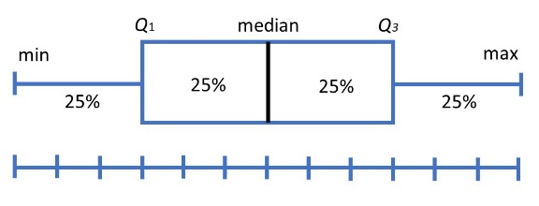
Simple Random vs Stratified
Recommend Stratified Simple Random Sampling
Strata defined by target values
Target distribution maintained across partitions
Caution about very uneven target values frequencies
Categorical
Continuous
Target Variable?
Recommend Simple Random Sampling
Check if target distributions in partitions are similar afterward

Slide 32
Metrics for Evaluation and Comparison
Statistics
Originated from statistical literature
Statistics: Root Mean Squared Errors, R-squared, Entropy and Gini
Binary Target
Originated from engineering literature for binary target
Receiver Operating Characteristic (ROC) charts, Area Under Curve, Confusion Matrix, Misclassification Rate, Root Mean Squared Errors, Root Average Squared Errors
Focus Group
Originated from direct marketing for target market segment
Lift and Gain Measures, Precision and Recall measures
Information Theory: Akaike's Information Criterion (AIC) and Bayesian Information Criterion (BIC)

Slide 33
Metrics for Interval Target
We aim to reduce the RASE or the relative error, but not all the way to zero.
If the RASE or the relative error is 0, then $y_{i}={\hat{y}}_{i}$ and the model has been overfitted.
If the relative error is 1, then predicted target value is practically same as observed mean.
We aim to reduce the RASE or the relative error, but not all the way to zero.
If the RASE or the relative error is 0, then 𝑦_𝑖=𝑦 ̂_𝑖 and the model has been overfitted.
If the relative error is 1, then predicted target value is practically same as observed mean.
Root Average Squared Error (RASE) = $\sqrt{\frac{1}{n}\sum_{i=1}^{n}{{\left(y_{i}−{\hat{y}}_{i}\right)}^{2}}}$
$y_{i}$ is the observed target value ${\hat{y}}_{i}$ is the predicted target value $n$ is the number of observations
Root Average Squared Error (RASE) = √(1/𝑛 ∑_(𝑖=1)^𝑛▒(𝑦_𝑖−𝑦 ̂_𝑖 )^2 )
𝑦_𝑖 is the observed target value 𝑦 ̂_𝑖 is the predicted target value 𝑛 is the number of observations
Relative Error = $\frac{\sum_{i=1}^{n}{{\left(y_{i}−{\hat{y}}_{i}\right)}^{2}}}{\sum_{i=1}^{n}{{\left(y_{i}−\overline{y}\right)}^{2}}}$
$\overline{y}$ is the observed target mean
Relative Error = (∑_(𝑖=1)^𝑛▒(𝑦_𝑖−𝑦 ̂_𝑖 )^2 )/(∑_(𝑖=1)^𝑛▒(𝑦_𝑖−𝑦 ̅ )^2 )
𝑦 ̅ is the observed target mean

Slide 34
Metrics for Binary Target Variable
Misclassification Rate
Area Under Curve (of Receiver Operating Characteristics)
Root Averaged Squared Error
Gini Coefficient
Goodman-Kruskal Gamma
Kolmogorov-Smirnov statistic

Slide 35
Binary Target Variable
Values are labelled Event and Non-Event
The classification model produces predicted probability for Event and predicted probability for Non-Event
Observed Target is Non-Event Predicted probabilities for Event are: $\left\{p_{k0}:k=1,…, n_{NE}\right\}$
Observed Target is Non-Event Predicted probabilities for Event are: {𝑝_𝑘0:𝑘=1,…, 𝑛_𝑁𝐸 }
Observed Target is Event Predicted probabilities for Event are: $\left\{p_{l1}:l=1,…, n_{E}\right\}$
Observed Target is Event Predicted probabilities for Event are: {𝑝_𝑙1:𝑙=1,…, 𝑛_𝐸 }

Slide 36
Misclassification Rate
Let 0 ≤ t ≤ 1 be the specified threshold
Observed Non-Event
If $p_{k0}≥t$, then predicted target is Event
If 𝑝_𝑘0≥𝑡, then predicted target is Event
If $p_{k0}<t$, then predicted target is Non-Event
If 𝑝_𝑘0<𝑡, then predicted target is Non-Event
Observed Event
If $p_{l1}≥t$, then predicted target is Event
If 𝑝_𝑙1≥𝑡, then predicted target is Event
If $p_{l1}<t$, then predicted target is Non-Event
If 𝑝_𝑙1<𝑡, then predicted target is Non-Event

Slide 37
Misclassification Rate
An observation is misclassified if the observed target value is not equal to the predicted target value
For a binary target, the conditions for misclassification are:
Observed Target = Event & Predicted Target = Non-Event
Observed Target = Non-Event & Predicted Target = Event
Misclassification Rate = (Number of misclassified observations) / (Number of observations)
Accuracy = 1 – Misclassification Rate
Express Accuracy and Misclassification Rate either as a fraction or as a percentage

Slide 38
Misclassification Rate
A common choice for threshold 0 ≤ t ≤ 1
The observed proportion of a particular target category in the training partition or in the entire data
The uninformative value of 1 / k where k is the number of target categories

Slide 39
Misclassification Rate for Binary Target
We often use the uninformative threshold 0.5
Common Wisdom
Traditionally, we determine the predicted category without explicitly using any threshold.
Predicted Event
If the predicted probability for Event is greater than or equal to the predicted probability for Non-Event
Predicted Non-Event
If the predicted probability for Event is less than the predicted probability for Non-Event

Slide 40

Binary Target Confusion Matrix
Misclassification Rate = (FP + FN) / (TP + FN + FP + TN)
True Positive Rate: Sensitivity = TP / (TP + FN)
True Negative Rate: Specificity = TN / (FP + TN)
Observed | Predicted
 | Event | Non-Event
Event | True Positive (TP) | False Negative (FN)
Non-Event | False Positive (FP) | True Negative (TN)

Slide 41
Misclassification Rate
Confusion Matrix
Observed | Predicted
 | Event | Non-Event
Event | 4 | 2
Non-Event | 2 | 3
Use the Uninformative Threshold of 0.5
Predicted Event if Predicted Event Probability ≥ 0.5
Number of observations is 11
Number of Misclassified observations is 4
Sensitivity = 4 / 6 = 66.67%
Specificity = 3 / 5 = 60%
Misclassification Rate = 4 / 11 = 36.36%
Observed Target Value | Predicted Event Probability | Prediction | Misclassified?
Event | 0.3 | Non-Event | 1
Event | 0.4 | Non-Event | 1
Event | 0.5 | Event | 0
Event | 0.7 | Event | 0
Event | 0.9 | Event | 0
Event | 1 | Event | 0
Non-Event | 0.2 | Non-Event | 0
Non-Event | 0.3 | Non-Event | 0
Non-Event | 0.3 | Non-Event | 0
Non-Event | 0.5 | Event | 1
Non-Event | 0.8 | Event | 1

Slide 42
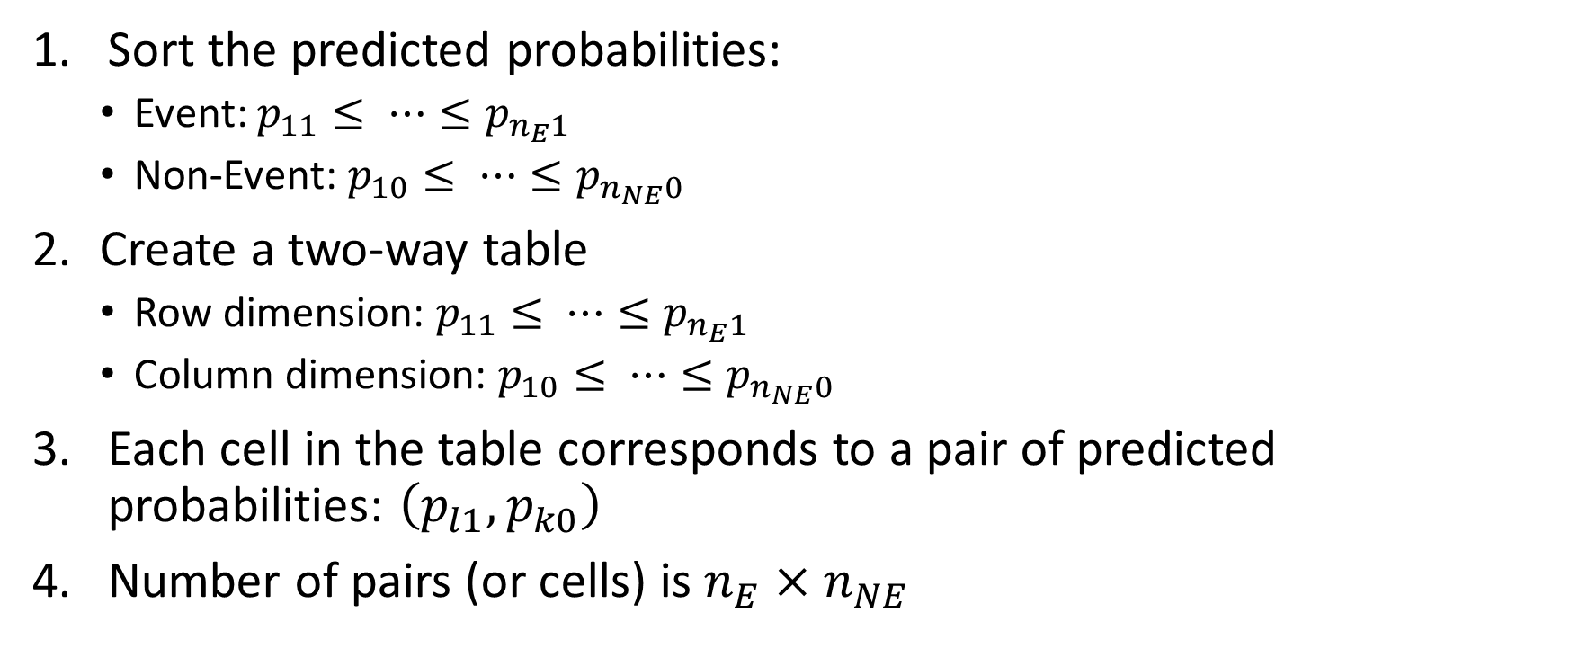
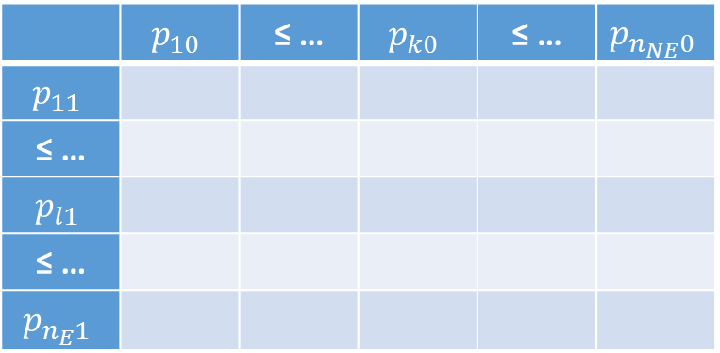
Area Under Curve (AUC)
Sort the predicted probabilities:
Event: $p_{11}≤ ⋯≤p_{n_{E}1}$
Non-Event: $p_{10}≤ ⋯≤p_{n_{NE}0}$
Create a two-way table
Row dimension: $p_{11}≤ ⋯≤p_{n_{E}1}$
Column dimension: $p_{10}≤ ⋯≤p_{n_{NE}0}$
Each cell in the table corresponds to a pair of predicted probabilities: $\left(p_{l1},p_{k0}\right)$
Number of pairs (or cells) is $n_{E}×n_{NE}$
 | $$p_{10}$$ | ≤ … | $$p_{k0}$$ | ≤ … | $$p_{n_{NE}0}$$
$$p_{11}$$
≤ …
$$p_{l1}$$
≤ …
$$p_{n_{E}1}$$

Slide 43
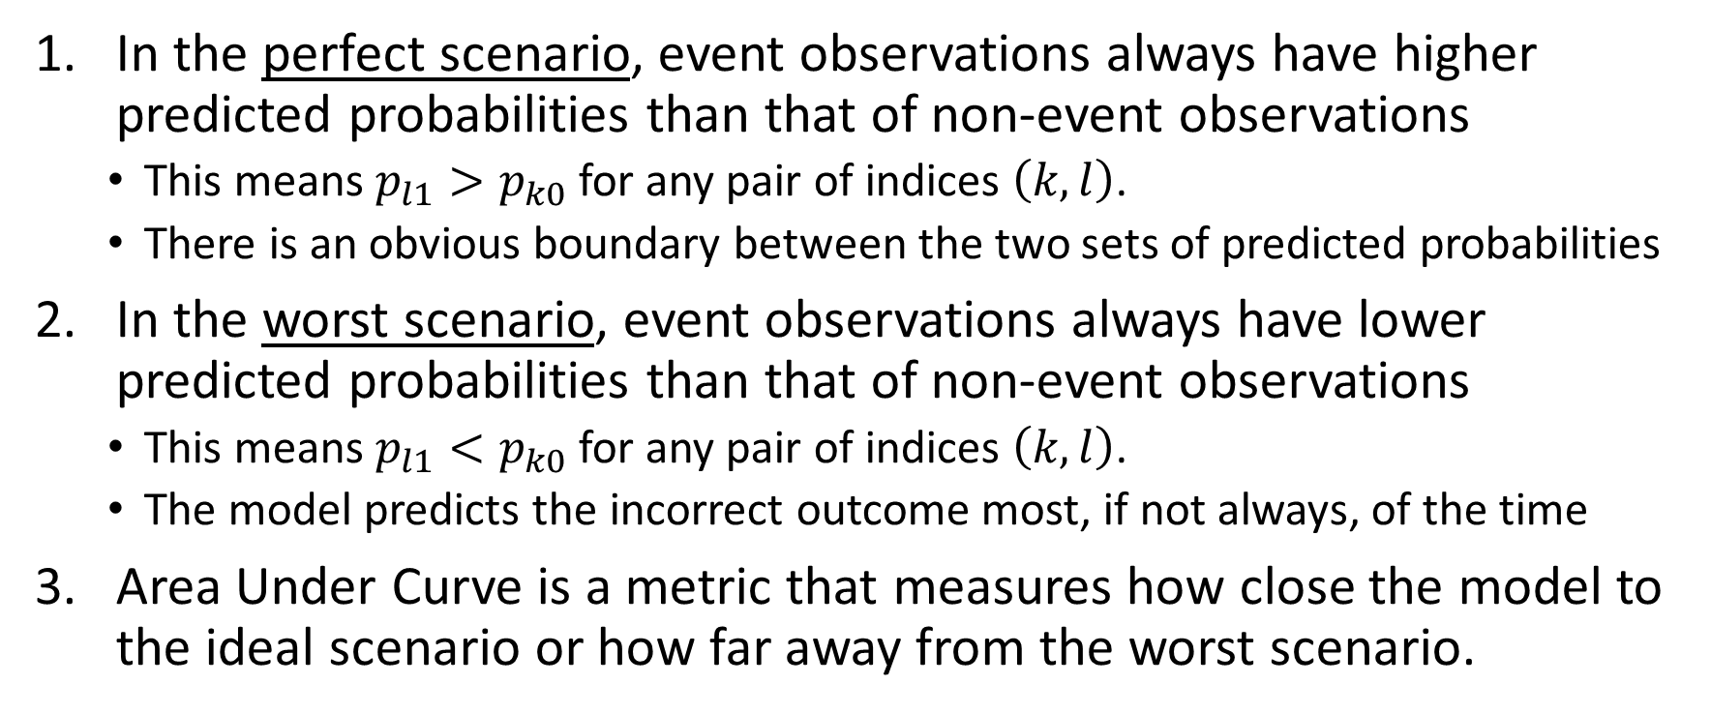
Area Under Curve (AUC)
In the perfect scenario, event observations always have higher predicted probabilities than that of non-event observations
This means $p_{l1}>p_{k0}$ for any pair of indices $\left(k,l\right)$.
There is an obvious boundary between the two sets of predicted probabilities
In the worst scenario, event observations always have lower predicted probabilities than that of non-event observations
This means $p_{l1}<p_{k0}$ for any pair of indices $\left(k,l\right)$.
The model predicts the incorrect outcome most, if not always, of the time
Area Under Curve is a metric that measures how close the model to the ideal scenario or how far away from the worst scenario.

Slide 44
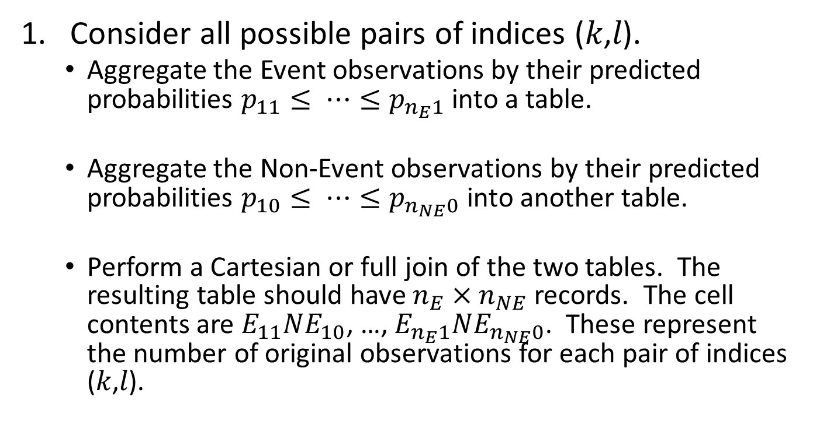
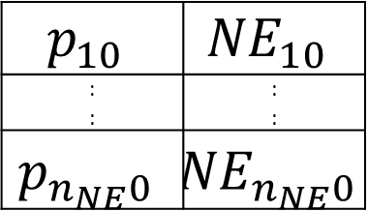
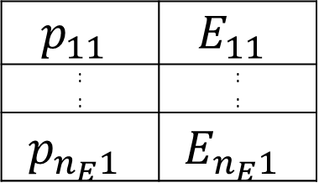
Area Under Curve (AUC): Algorithm
$$p_{11}$$ | $$E_{11}$$
: : | : :
$$p_{n_{E}1}$$ | $$E_{n_{E}1}$$
Consider all possible pairs of indices (𝑘,𝑙).
Aggregate the Event observations by their predicted probabilities $p_{11}≤ ⋯≤p_{n_{E}1}$ into a table.
Aggregate the Non-Event observations by their predicted probabilities $p_{10}≤ ⋯≤p_{n_{NE}0}$ into another table.
Perform a Cartesian or full join of the two tables. The resulting table should have $n_{E}×n_{NE}$ records. The cell contents are $E_{11}{NE}_{10}$, …, $E_{n_{E}1}{NE}_{n_{NE}0}$. These represent the number of original observations for each pair of indices (𝑘,𝑙).
$$p_{10}$$ | $${NE}_{10}$$
: : | : :
$$p_{n_{NE}0}$$ | $${NE}_{n_{NE}0}$$

Slide 45
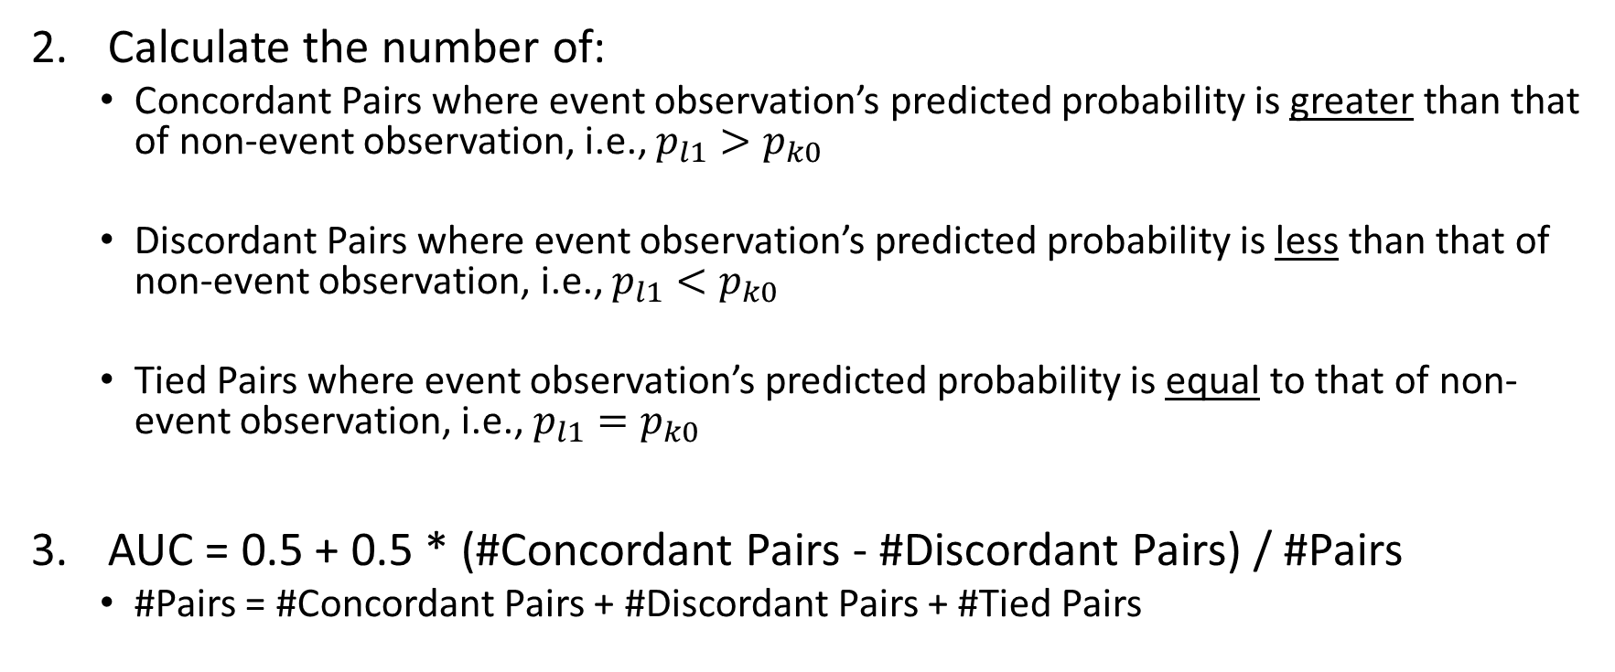
Area Under Curve (AUC): Algorithm
Calculate the number of:
Concordant Pairs where event observation’s predicted probability is greater than that of non-event observation, i.e., $p_{l1}>p_{k0}$
Discordant Pairs where event observation’s predicted probability is less than that of non-event observation, i.e., $p_{l1}<p_{k0}$
Tied Pairs where event observation’s predicted probability is equal to that of non-event observation, i.e., $p_{l1}=p_{k0}$
AUC = 0.5 + 0.5 * (#Concordant Pairs - #Discordant Pairs) / #Pairs
#Pairs = #Concordant Pairs + #Discordant Pairs + #Tied Pairs

Slide 46
Area Under Curve (AUC): Example
Observed Target Value | Predicted Event Probability
Event | 0.9
Non-Event | 0.5
Non-Event | 0.3
Event | 0.7
Event | 0.3
Non-Event | 0.8
Event | 0.4
Non-Event | 0.2
Event | 1.0
Event | 0.5
Non-Event | 0.3
The target is a binary variable
The target values are Event and Non-Event.
The table (on the left) contains the observed target value and the predicted event probabilities.

Slide 47
Area Under Curve (AUC): Example
Observed Target Value | Predicted Event Probability
Event | 0.3
Event | 0.4
Event | 0.5
Event | 0.7
Event | 0.9
Event | 1.0
Non-Event | 0.2
Non-Event | 0.3
Non-Event | 0.3
Non-Event | 0.5
Non-Event | 0.8
Group the predicted probabilities into Event and Non-Event groups
Sort the predicted probabilities in ascending order within each group
Notice the ties?

Slide 48
Area Under Curve (AUC): Example
 |  | Non-Event Prob.
 |  | 0.2 | 0.3 | 0.3 | 0.5 | 0.8
Event Prob. | 0.3 | C | T | T | D | D
 | 0.4 | C | C | C | D | D
 | 0.5 | C | C | C | T | D
 | 0.7 | C | C | C | C | D
 | 0.9 | C | C | C | C | C
 | 1 | C | C | C | C | C
Define the pairs as Concordant (C), Discordant (D), and Tied (T) pairs
Count the numbers of each type of pair

Slide 49
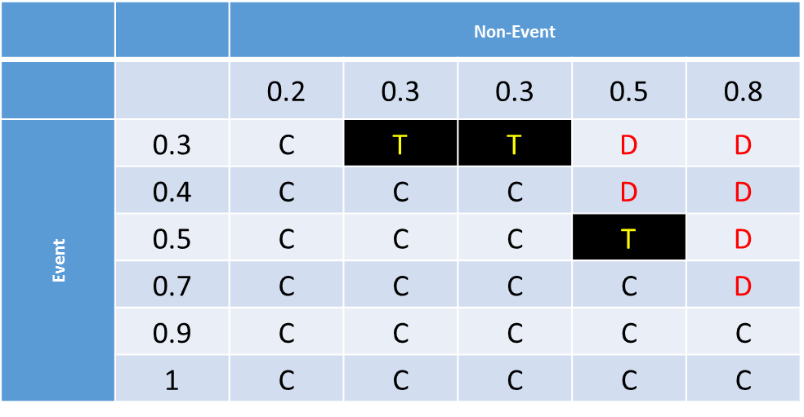
Area Under Curve (AUC): Example
Number of pairs = 6 x 5 = 30
Number of concordant (C) pairs is 21
Number of discordant (D) pairs is 6
Number of ties (T) pairs is 3
The Area Under Curve metric = 0.5 + 0.5 x (21 – 6) / 30 = 0.5 + 0.5 x 0.5 = 0.75

Slide 50
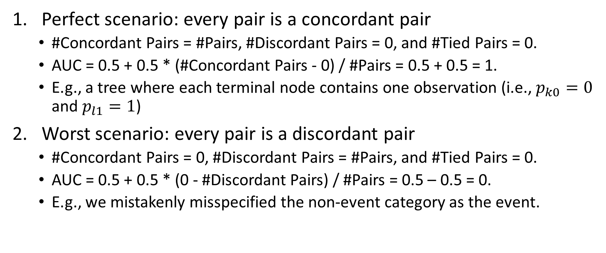
Area Under Curve (AUC)
Perfect scenario: every pair is a concordant pair
#Concordant Pairs = #Pairs, #Discordant Pairs = 0, and #Tied Pairs = 0.
AUC = 0.5 + 0.5 * (#Concordant Pairs - 0) / #Pairs = 0.5 + 0.5 = 1.
E.g., a tree where each terminal node contains one observation (i.e., $p_{k0}=0$ and $p_{l1}=1$)
Worst scenario: every pair is a discordant pair
#Concordant Pairs = 0, #Discordant Pairs = #Pairs, and #Tied Pairs = 0.
AUC = 0.5 + 0.5 * (0 - #Discordant Pairs) / #Pairs = 0.5 – 0.5 = 0.
E.g., we mistakenly misspecified the non-event category as the event.

Slide 51
Area Under Curve (AUC)
Inconclusive Scenario
Either every pair is a tied pair, AUC = 0.5 + 0.5 * (0 – 0) / #Pairs = 0.5
Or #Concordant Pairs = #Discordant Pairs, AUC = 0.5 + 0.5 * 0 = 0.5
E.g., an intercept only model where all predicted probabilities are equal for event and non-event observations.
Acceptable model: AUC > 0.5
Higher the AUC above 0.5, better the model.

Slide 52
Area Under Curve (AUC)
Pros
Does not require a threshold that predicts an observation as Event versus Non-Event
The AUC value is between 0 and 1 and a reference value of 0.5
Cons
Uses only the relative order of predicted probabilities and ignores the actual values
Summarizes model performance over intervals of probabilities which are mediocre values, e.g. [0.3, 0.7]

Slide 53
Gini Coefficient
# Pairs = # Concordant + # Discordant + # Tied
Gini Coefficient = (# Concordant - # Discordant) / # Pairs
Gini = 2 * AUC - 1
Perfect scenario: every pair is a concordant pair ➔ Gini = 1
Worst scenario: every pair is a discordant pair ➔Gini = -1
Inconclusive Scenario: # Concordant = # Discordant ➔ Gini = 0
Acceptable model: Gini > 0
Higher the Gini above 0, better the model

Slide 54
Goodman-Kruskal Gamma
Goodman-Kruskal Gamma = (# Concordant - # Discordant) / (#Concordant + #Discordant)
Perfect scenario: every pair is a concordant pair ➔ Gamma = 1
Worst scenario: every pair is a discordant pair ➔Gamma = -1
Inconclusive Scenario: # Concordant = # Discordant ➔ Gamma = 0
Acceptable model: Gamma > 0
Higher the Gamma above 0, better the model

Slide 55
Gini and Gamma: Example
Number of concordant (C) pairs is 21
Number of discordant (D) pairs is 6
Number of ties (T) pairs is 3
Gini = (21 – 6) / (21 + 6 + 3) = 15 / 30 = 0.5
Gamma = (21 – 6) / (21 + 6) = 15 / 27 = 0.5556

Slide 56
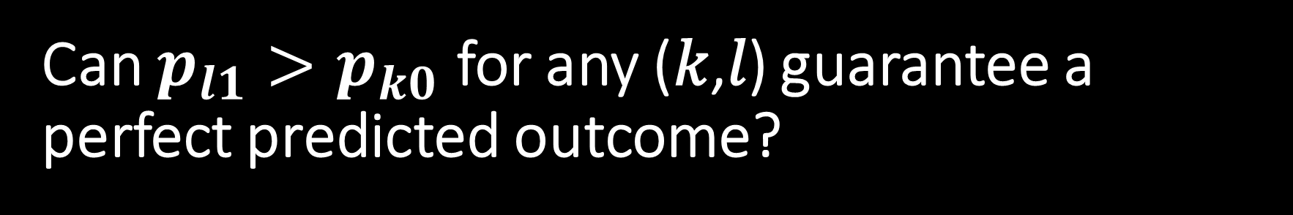
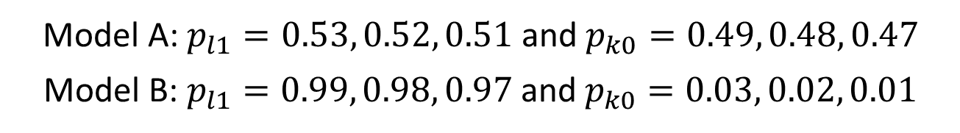
Can $p_{l1}>p_{k0}$ for any (𝑘,𝑙) guarantee a perfect predicted outcome?
3 Event Obs.,
3 Non-Event Obs.
Model A: $p_{l1}=0.53, 0.52, 0.51$ and $p_{k0}=0.49, 0.48, 0.47$
Model B: $p_{l1}=0.99, 0.98, 0.97$ and $p_{k0}=0.03, 0.02, 0.01$
Area Under Curve
Both models’ AUCs are one
Model B is clearly preferred
Predict Event if $p>0.95$
Predict Event if 𝑝>0.95
Model A will predict a non-event for all observations
Misclassification Rate Model A: 50% Model B: 0%
Predict Event if $p>0.05$
Predict Event if 𝑝>0.05
Model A will predict an event for all observations
Misclassification Rate Model A: 50% Model B: 0%

Slide 57
Root Average Squared Error (RASE): Rationale
If a model fits the data well, then we anticipate the predicted event probabilities to be:
Closer to 1 when the observed target value is an Event
Closer to 0 when the observed target value is a Non-Event
Therefore we will derive a metric that shows how close, on average, the predicted event probabilities are to their respective anticipated values.

Slide 58
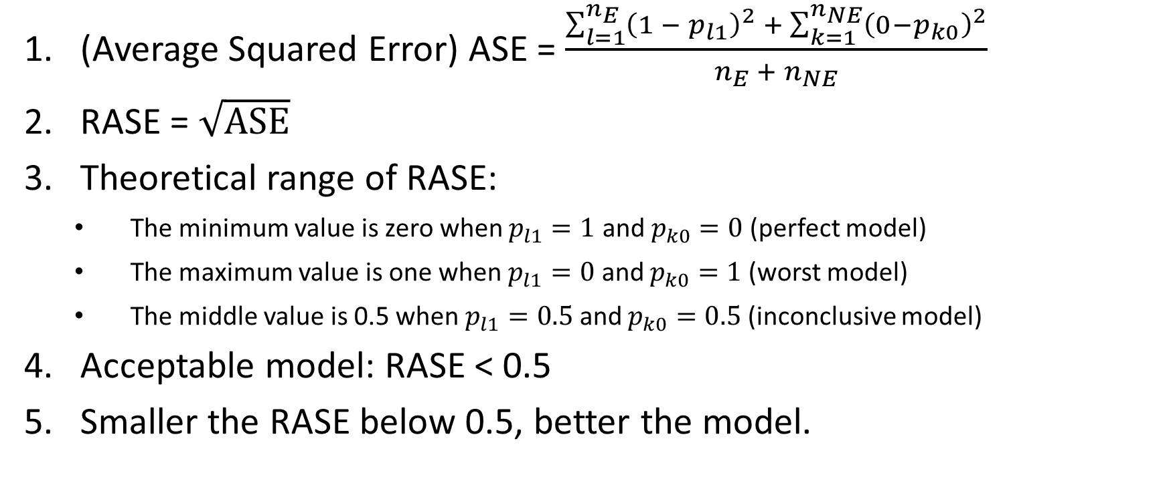
Root Average Squared Error (RASE): Algorithm
(Average Squared Error) ASE = $\frac{\sum_{l=1}^{n_{E}}{{\left({1 − p}_{l1}\right)}^{2} + \sum_{k=1}^{n_{NE}}{{\left(0−p_{k0}\right)}^{2}}}}{n_{E} +{ n}_{NE}}$
RASE = $\sqrt{ASE}$
Theoretical range of RASE:
The minimum value is zero when $p_{l1}=1$ and $p_{k0}=0$ (perfect model)
The maximum value is one when $p_{l1}=0$ and $p_{k0}=1$ (worst model)
The middle value is 0.5 when $p_{l1}=0.5$ and $p_{k0}=0.5$ (inconclusive model)
Acceptable model: RASE < 0.5
Smaller the RASE below 0.5, better the model.

Slide 59
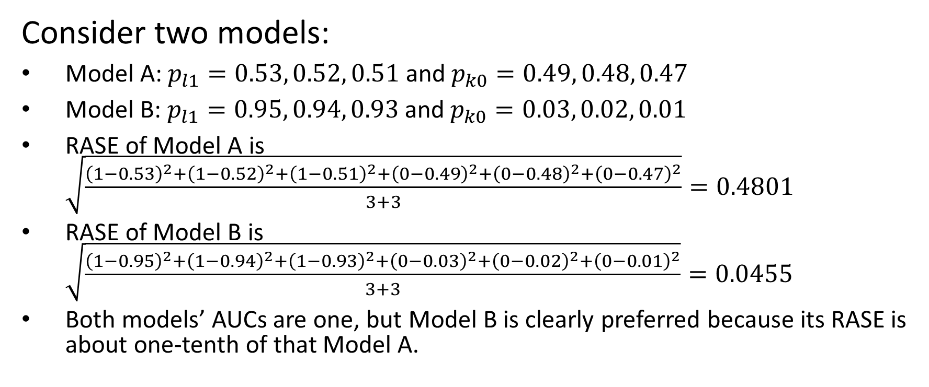
Root Average Squared Error (RASE)
Consider two models:
Model A: $p_{l1}=0.53, 0.52, 0.51$ and $p_{k0}=0.49, 0.48, 0.47$
Model B: $p_{l1}=0.95, 0.94, 0.93$ and $p_{k0}=0.03, 0.02, 0.01$
RASE of Model A is $\sqrt{\frac{{\left(1−0.53\right)}^{2}+{\left(1−0.52\right)}^{2}+{\left(1−0.51\right)}^{2}+{\left(0−0.49\right)}^{2}+{\left(0−0.48\right)}^{2}+{\left(0−0.47\right)}^{2}}{3+3}}=0.4801$
RASE of Model B is $\sqrt{\frac{{\left(1−0.95\right)}^{2}+{\left(1−0.94\right)}^{2}+{\left(1−0.93\right)}^{2}+{\left(0−0.03\right)}^{2}+{\left(0−0.02\right)}^{2}+{\left(0−0.01\right)}^{2}}{3+3}}=0.0455$
Both models’ AUCs are one, but Model B is clearly preferred because its RASE is about one-tenth of that Model A.

Slide 60
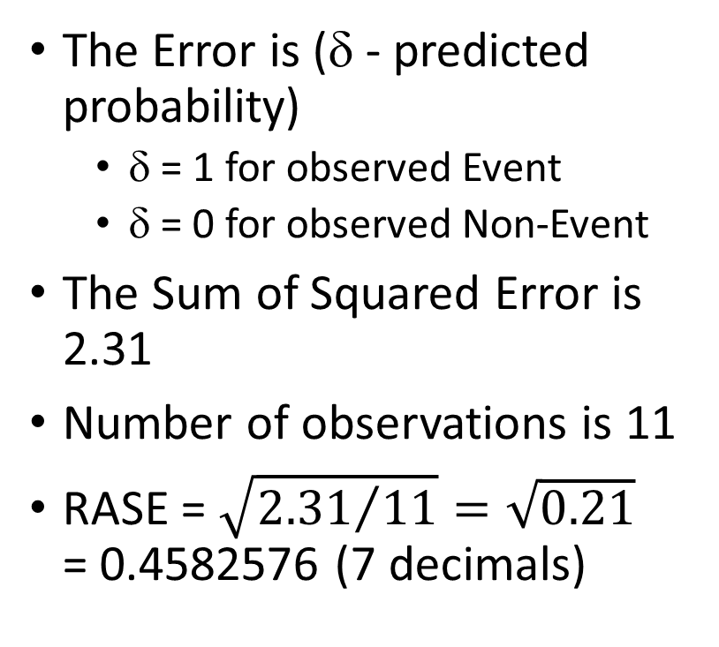
Root Average Squared Error (RASE): Example
The Error is (δ - predicted probability)
δ = 1 for observed Event
δ = 0 for observed Non-Event
The Sum of Squared Error is 2.31
Number of observations is 11
RASE = $\sqrt{{2.31}/{11}}=\sqrt{0.21}$ = 0.4582576 (7 decimals)
Observed Target Value | Predicted Event Probability | Error | Squared Error
Event | 0.3 | 0.7 | 0.49
Event | 0.4 | 0.6 | 0.36
Event | 0.5 | 0.5 | 0.25
Event | 0.7 | 0.3 | 0.09
Event | 0.9 | 0.1 | 0.01
Event | 1 | 0 | 0
Non-Event | 0.2 | -0.2 | 0.04
Non-Event | 0.3 | -0.3 | 0.09
Non-Event | 0.3 | -0.3 | 0.09
Non-Event | 0.5 | -0.5 | 0.25
Non-Event | 0.8 | -0.8 | 0.64
 |  | Total | 2.31

Slide 61
Model Assessment Example
Observed Target Value | Predicted Event Probability
Event | 0.9
Non-Event | 0.5
Non-Event | 0.3
Event | 0.7
Event | 0.3
Non-Event | 0.8
Event | 0.4
Non-Event | 0.2
Event | 1.0
Event | 0.5
Non-Event | 0.3
Performance Metrics
AUC = 0.75
RASE = 0.4582576
Misclassification Rate = 0.3636363 (for threshold = 0.5 and 0.54)
Gini = 0.5
Gamma = 0.5556
Based on these five metrics, the model fits the data adequately

Slide 62
Model Assessment Example
import matplotlib.pyplot as plt
import numpy
import sklearn.metrics as metrics
Y = numpy.array(['Event',
'Non-Event',
'Non-Event',
'Event',
'Event',
'Non-Event',
'Event',
'Non-Event',
'Event',
'Event',
'Non-Event'])
nY = Y.shape[0]
predProbY = numpy.array([0.9,0.5,0.3,0.7,0.3,0.8,0.4,0.2,1,0.5,0.3])

Slide 63
Model Assessment Example
# Determine the predicted class of Y
predY = numpy.empty_like(Y)
for i in range(nY):
if (predProbY[i] > 0.5):
predY[i] = 'Event'
else:
predY[i] = 'Non-Event'
# Calculate the Root Average Squared Error
RASE = 0.0
for i in range(nY):
if (Y[i] == 'Event'):
RASE += (1 - predProbY[i])**2
else:
RASE += (0 - predProbY[i])**2
RASE = numpy.sqrt(RASE/nY)
# Calculate the Root Mean Squared Error
Y_true = 1.0 * numpy.isin(Y, ['Event’])
RMSE = metrics.mean_squared_error(Y_true, predProbY)
RMSE = numpy.sqrt(RMSE)
Make ‘Event’ into True and finally to 1.
Otherwise, into False and finally to 0.

Slide 64
Model Assessment Example
# For binary y_true, y_score is supposed to be the score of the class with greater label.
AUC = metrics.roc_auc_score(Y_true, predProbY)
accuracy = metrics.accuracy_score(Y, predY)
print(' Accuracy: {:.13f}' .format(accuracy))
print(' Misclassification Rate: {:.13f}' .format(1-accuracy))
print(' Area Under Curve: {:.13f}' .format(AUC))
print('Root Average Squared Error: {:.13f}' .format(RASE))
print(' Root Mean Squared Error: {:.13f}' .format(RMSE))
------ Results ------
Accuracy: 0.6363636363636
Misclassification Rate: 0.3636363636364
Area Under Curve: 0.7500000000000
Root Average Squared Error: 0.4582575694956
Root Mean Squared Error: 0.4582575694956
Q: Where are Gini Coefficient and Goodman and Krushal Gamma?
A: Write your code to calculate them

Slide 65
Common Metric for Nominal Target
Area Under Curve
Root Average Squared Error
Misclassification Rate

Slide 66
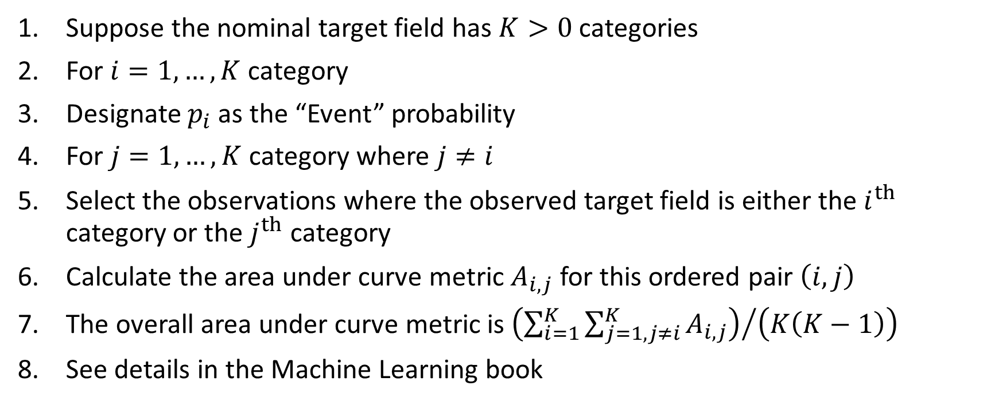
Area Under Curve for Nominal Target
Suppose the nominal target field has $K>0$ categories
For $i=1,…,K$ category
Designate $p_{i}$ as the “Event” probability
For $j=1,…,K$ category where $j≠i$
Select the observations where the observed target field is either the $i^{th}$ category or the $j^{th}$ category
Calculate the area under curve metric $A_{i,j}$ for this ordered pair $\left(i,j\right)$
The overall area under curve metric is ${\left(\sum_{i=1}^{K}{\sum_{j=1,j≠i}^{K}{A_{i,j}}}\right)}/{\left(K\left(K−1\right)\right)}$
See details in the Machine Learning book

Slide 67
Misclassification Rate for Nominal Target
Determine the predicted target category
e.g., the lexically lowest category which has the highest predicted probability
An observation is misclassified if the predicted target category is different from the observed target category.
Calculate the percents of observations that are misclassified.

Slide 68
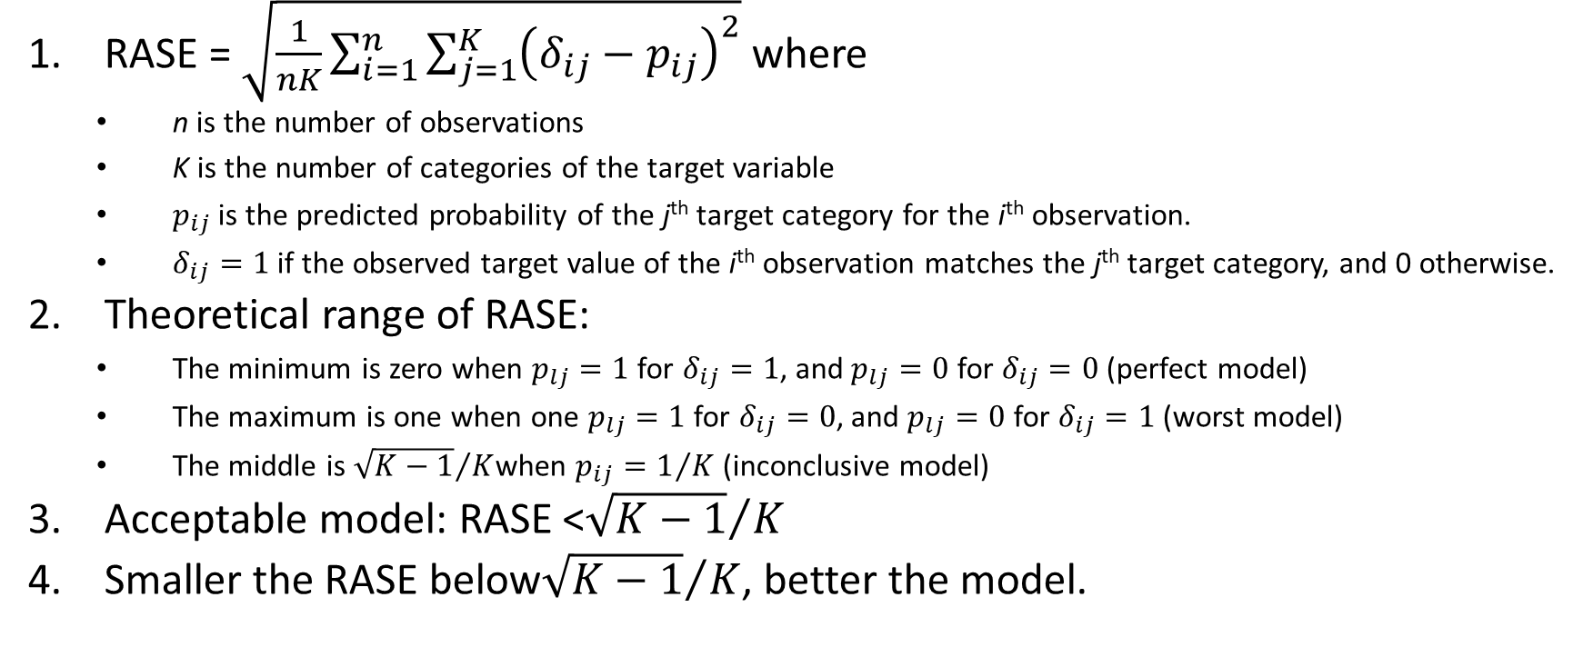
Root Average Squared Error (RASE): Algorithm
RASE = $\sqrt{\frac{1}{nK}\sum_{i=1}^{n}{\sum_{j=1}^{K}{{\left(δ_{ij}−p_{ij}\right)}^{2}}}}$ where
n is the number of observations
K is the number of categories of the target variable
$p_{ij}$ is the predicted probability of the j^{th} target category for the i^{th} observation.
$δ_{ij}=1$ if the observed target value of the i^{th} observation matches the j^{th} target category, and 0 otherwise.
Theoretical range of RASE:
The minimum is zero when $p_{lj}=1$ for $δ_{ij}=1$, and $p_{lj}=0$ for $δ_{ij}=0$ (perfect model)
The maximum is one when one $p_{lj}=1$ for $δ_{ij}=0$, and $p_{lj}=0$ for $δ_{ij}=1$ (worst model)
The middle is ${\sqrt{K−1}}/K$when $p_{ij}=1/K$ (inconclusive model)
Acceptable model: RASE <${\sqrt{K−1}}/K$
Smaller the RASE below${\sqrt{K−1}}/K$, better the model.

Slide 69

ROC Curve for Binary Target: Introduction
Introducing the “Curve” in the “Area Under Curve”.
The “Curve” is the Receiver Operating Characteristics (ROC) curve
ROC curves were developed in the 1950s as a by-product of research into making sense of radio signals contaminated by noise
After the 1941 Attack on Pearl Harbor, the United States Army began new research to increase the accuracy of detecting Japanese aircrafts from their radar signals
False Positive leads to weapon fire on airplanes from one's own side
False Negative leads to an actual enemy attack

Slide 70
ROC Curve: Motivations
If my model fits the data well, then an observed Event will also be predicted an Event most of the times.
However, predicting an Event depends on our threshold for the predicted Event probability.
The ROC curve can tell us how big that likelihood is over all possible choices of threshold.

Slide 71
ROC Curve: Focus on Predicting Event
 | Predicted Non-Event | Predicted Event | Total Observed
Observed Non-Event | A (true negative) | B (false positive) | A + B
Observed Event | C (false negative) | D (true positive) | C + D
Total Predicted | A + C | B + D | A + B + C + D
True Positive Rate: Sensitivity = (D / (C + D))
False Positive Rate: 1 – Specificity = (B / (A + B))
When the threshold goes down, then True Positive increases but False Positive also increases.
When the threshold goes up, then False Positive decreases but True Positive also decreases.
Our goal is to show the relationship between True Positive and False Positive for all possible thresholds.

Slide 72
ROC Curve: Construction
Find Thresholds
Create a set of distinct values from the predicted event probabilities
Assign Event
Use each element of this set as a threshold to assign each observation into Predicted Event and Predicted Non-Event
Calculate Coordinates
Vertical Axis (True Positive Rate): Sensitivity = (D / (C + D))
Horizontal Axis (False Positive Rate): 1 – Specificity = (B / (A + B))
Assign an observation Predicted Event if Predicted Event Probability  Threshold
 | Predicted Non-Event | Predicted Event | Total Observed
Observed Non-Event | A (true negative) | B (false positive) | A + B
Observed Event | C (false negative) | D (true positive) | C + D
Total Predicted | A + C | B + D | A + B + C + D

Slide 73
ROC Curve: Example
The set of distinct predicted event probabilities is: {0.2, 0.3, 0.4, 0.5, 0.7, 0.8, 0.9, 1.0}.
Number of Observed Event = 6
Number of Observed Non-Event = 5
Observed Target Value | Predicted Event Probability
Event | 0.9
Non-Event | 0.5
Non-Event | 0.3
Event | 0.7
Event | 0.3
Non-Event | 0.8
Event | 0.4
Non-Event | 0.2
Event | 1.0
Event | 0.5
Non-Event | 0.3

Slide 74
ROC Curve: Example
True Positive: Event
True Negative: Non-Event
Observed Target Value | Predicted Event Probability | Threshold: 0.2 | Threshold: 0.3 | Threshold: 0.4 | Threshold: 0.5 | Threshold: 0.7 | Threshold: 0.8 | Threshold: 0.9 | Threshold: 1.0
Non-Event | 0.2 | Event | Non-Event | Non-Event | Non-Event | Non-Event | Non-Event | Non-Event | Non-Event
Event | 0.3 | Event | Event | Non-Event | Non-Event | Non-Event | Non-Event | Non-Event | Non-Event
Non-Event | 0.3 | Event | Event | Non-Event | Non-Event | Non-Event | Non-Event | Non-Event | Non-Event
Non-Event | 0.3 | Event | Event | Non-Event | Non-Event | Non-Event | Non-Event | Non-Event | Non-Event
Event | 0.4 | Event | Event | Event | Non-Event | Non-Event | Non-Event | Non-Event | Non-Event
Event | 0.5 | Event | Event | Event | Event | Non-Event | Non-Event | Non-Event | Non-Event
Non-Event | 0.5 | Event | Event | Event | Event | Non-Event | Non-Event | Non-Event | Non-Event
Event | 0.7 | Event | Event | Event | Event | Event | Non-Event | Non-Event | Non-Event
Non-Event | 0.8 | Event | Event | Event | Event | Event | Event | Non-Event | Non-Event
Event | 0.9 | Event | Event | Event | Event | Event | Event | Event | Non-Event
Event | 1.0 | Event | Event | Event | Event | Event | Event | Event | Event
Threshold | 0.2 | 0.3 | 0.4 | 0.5 | 0.7 | 0.8 | 0.9 | 1
# TP | 6 | 6 | 5 | 4 | 3 | 2 | 2 | 1
# TN | 0 | 1 | 3 | 3 | 4 | 4 | 5 | 5
Sensitivity | 6/6=1.00 | 1.00 | 0.83 | 0.67 | 0.50 | 0.33 | 0.33 | 0.17
1 – Specificity | 1-0/5=1.00 | 0.80 | 0.40 | 0.40 | 0.20 | 0.20 | 0.00 | 0.00

Slide 75
ROC Curve: Example
Since the ROC Curve routinely includes the coordinates (0,0) and (1,1), you may need to add these two coordinates if they are not already there.
Threshold | 0.2 | 0.3 | 0.4 | 0.5 | 0.7 | 0.8 | 0.9 | 1
# TP | 6 | 6 | 5 | 4 | 3 | 2 | 2 | 1
# TN | 0 | 1 | 3 | 3 | 4 | 4 | 5 | 5
Sensitivity | 1.00 | 1.00 | 0.83 | 0.67 | 0.50 | 0.33 | 0.33 | 0.17
1 – Specificity | 1.00 | 0.80 | 0.40 | 0.40 | 0.20 | 0.20 | 0.00 | 0.00

Slide 76
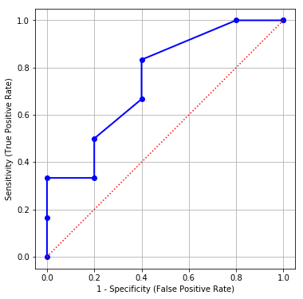
ROC Curve: Example
# Generate the coordinates for the ROC curve
fpr, tpr, thresholds = metrics.roc_curve(Y, predProbY,
pos_label = 'Event')
# Add two dummy coordinates
OneMinusSpecificity = numpy.append([0], fpr)
Sensitivity = numpy.append([0], tpr)
OneMinusSpecificity = numpy.append(OneMinusSpecificity, [1])
Sensitivity = numpy.append(Sensitivity, [1])
# Draw the ROC curve
plt.figure(figsize=(6,6))
plt.plot(OneMinusSpecificity, Sensitivity, marker = 'o',
color = 'blue', linestyle = 'solid', linewidth = 2, markersize = 6)
plt.plot([0, 1], [0, 1], color = 'red', linestyle = ':')
plt.grid(True)
plt.xlabel("1 - Specificity (False Positive Rate)")
plt.ylabel("Sensitivity (True Positive Rate)")
plt.axis("equal")
plt.show()

Slide 77
ROC Curve: Interpretations
If I can tolerate a particular percent of False Positive, then what percent of True Positive I will get?
If I can tolerate up to 10% of False Positive, then I can get up to 33% of True Positive (Sensitivity)
If I can tolerate up to 20% of False Positive, then I can get up to 50% of True Positive

Slide 78
ROC Curve: Interpretations
If I want a certain percent of True Positive, then what percent of False Positive do I need to tolerate?
If I want at least 80% of True Positive, then I need to tolerate at least 40% of False Positive (1 – Specificity)
If I want at least 40% of True Positive, then I need to tolerate at least 20% of False Positive

Slide 79
Kolmogorov Smirnov Chart
Q: Can the ROC chart help us determine the probability cutoff?
Plot True Positive Rate and False Positive Rate versus Threshold
Identify the Threshold where the biggest gap between the two curves occur

Slide 80
Kolmogorov Smirnov Chart
True Positive Rate is the Sensitivity
False Positive Rate is the 1 - Specificity
Threshold | 0.2 | 0.3 | 0.4 | 0.5 | 0.7 | 0.8 | 0.9 | 1
# TP | 6 | 6 | 5 | 4 | 3 | 2 | 2 | 1
# TN | 0 | 1 | 3 | 3 | 4 | 4 | 5 | 5
Sensitivity | 1.00 | 1.00 | 0.83 | 0.67 | 0.50 | 0.33 | 0.33 | 0.17
1 – Specificity | 1.00 | 0.80 | 0.40 | 0.40 | 0.20 | 0.20 | 0.00 | 0.00

Slide 81
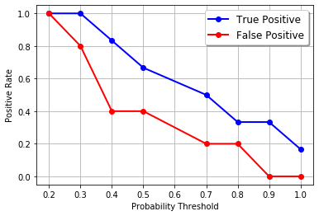
Kolmogorov Smirnov Chart
# Draw the Kolmogorov Smirnov curve
cutoff = numpy.where(thresholds > 1.0, numpy.nan,
thresholds)
plt.plot(cutoff, tpr, marker = 'o’,
label = 'True Positive’,
color = 'blue', linestyle = 'solid')
plt.plot(cutoff, fpr, marker = 'o’,
label = 'False Positive',
color = 'red', linestyle = 'solid')
plt.grid(True)
plt.xlabel("Probability Threshold")
plt.ylabel("Positive Rate")
plt.legend(loc = 'upper right', shadow = True)
plt.show()

Slide 82
Kolmogorov Smirnov Chart
The Kolmogorov Smirnov statistic is the largest difference between True Positive and False Positive.
The KS statistic is 0.43333333.
The largest difference happens when the probability threshold is 0.4.
This 0.4 value is one of the possible probability thresholds for declaring an Event.

Slide 83

Assignment 3
Assignment 3 has six questions
Submit your Python codes with your homework submission
Due date is 11:59 pm on Sunday, October 11, 2020

